Slide 1


Slide 2
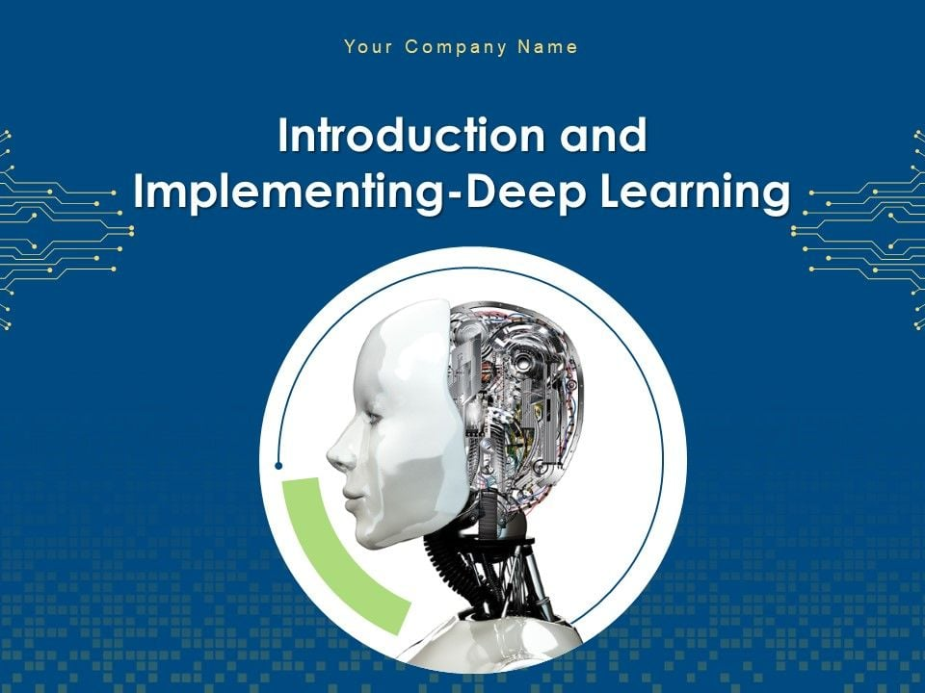

Slide 3
Introduction to DL
Introduction to Deep Learning
Perceptron Model
Introduction to Tensorflow and Keras
Introduction to Types of Neural Networks

Slide 4
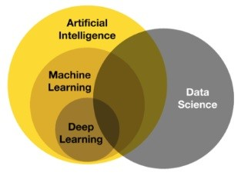
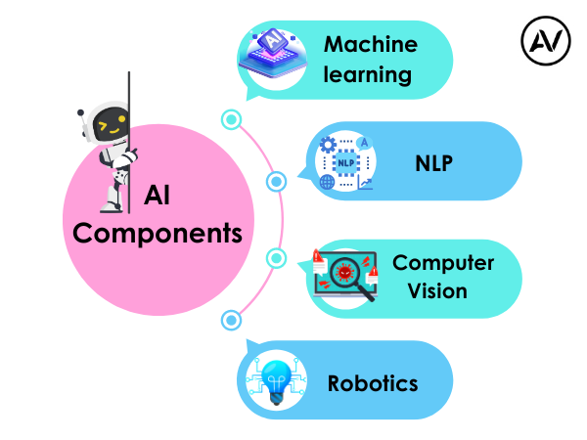
https://ellow.io/components-of-ai/

Slide 5
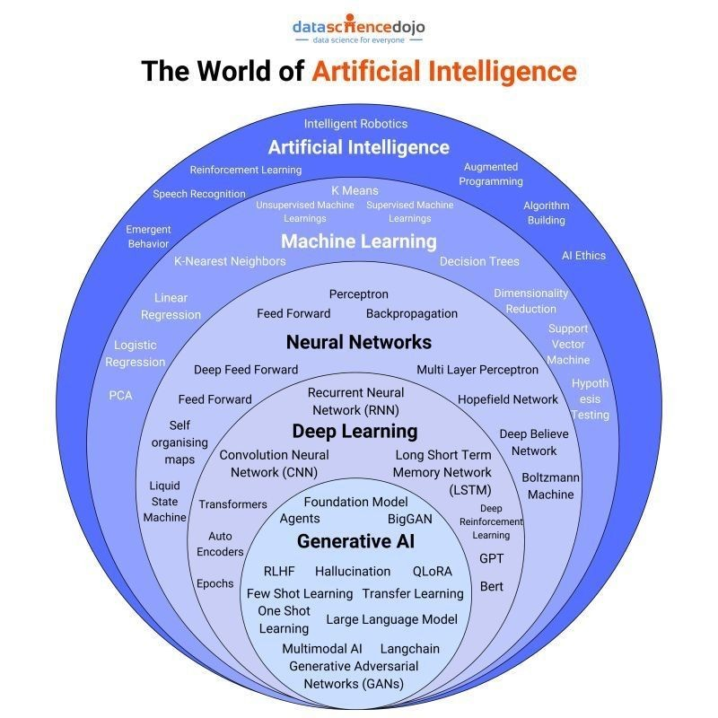
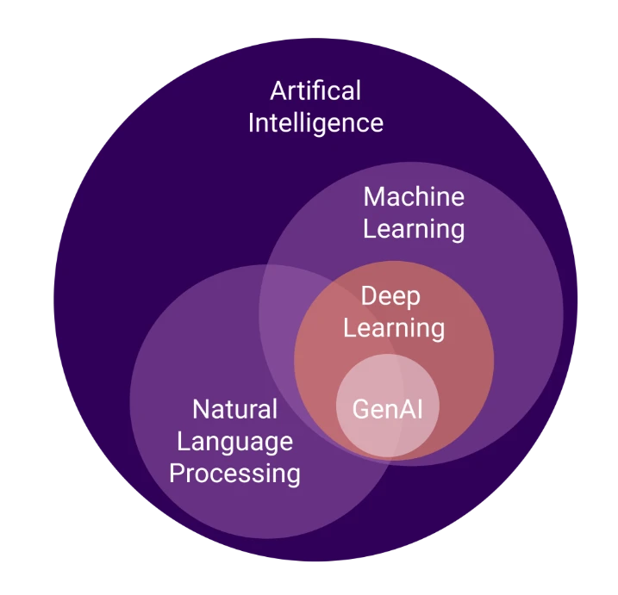
Algorithms and models

Slide 6
Artificial Intelligence (AI) refers to the simulation of human intelligence in machines that are designed to think, learn, and make decisions. AI encompasses a wide range of technologies, including rule-based systems, expert systems, and machine learning algorithms.
Key Features of AI:
Automation of tasks that require human intelligence.
Ability to learn from data and improve over time.
Applications across various domains, including healthcare, finance, and robotics.

Slide 7
AI vs ML vs DL
Artificial Intelligence (AI):
The broadest concept, referring to machines that can perform cognitive functions similar to humans.
Encompasses ML, DL, and rule-based systems.
Examples: Virtual assistants, autonomous vehicles, and recommendation systems.
Machine Learning (ML):
A subset of AI that enables machines to learn patterns from data without explicit programming.
Uses statistical models and algorithms like decision trees, regression, and clustering.
Examples: Fraud detection, predictive analytics, and spam filters.
Deep Learning (DL):
A specialized subset of ML that relies on deep neural networks.
Requires large datasets and computational power.
Examples: Image recognition, natural language processing, and speech recognition.
Applications of AI
AI has transformed multiple industries by enabling automation and improving decision-making. Some major applications include:
Healthcare: Disease diagnosis, personalized medicine, robotic surgeries.
Finance: Fraud detection, algorithmic trading, risk assessment.
Retail: Recommendation systems, demand forecasting, customer sentiment analysis.
Autonomous Systems: Self-driving cars, drones, robotics.
Natural Language Processing: Chatbots, virtual assistants, language translation.

Slide 8
Conventional AI vs Generative AI (GenAI)
Conventional AI:
Focuses on classification, prediction, and rule-based decision-making.
Uses structured datasets for training.
Examples: Spam filters, customer service chatbots, recommendation engines.
Generative AI (GenAI):
A type of AI that creates new content, such as text, images, and music.
Uses models like GANs (Generative Adversarial Networks) and transformers (e.g., GPT, DALL-E).
Examples: AI-generated art, chat-based content generation, and text-to-image synthesis.
Future of AI
The future of AI is expected to bring significant advancements and challenges:
AI-Augmented Creativity: More sophisticated generative models for content creation.
Explainable AI (XAI): Enhancing transparency and trust in AI decision-making.
Ethical AI Development: Addressing biases, privacy concerns, and responsible AI use.
AI in Edge Computing: Deployment of AI models on edge devices for real-time processing.
Superintelligence and AGI: Theoretical advancements toward artificial general intelligence (AGI) with human-like reasoning capabilities.
AI continues to evolve, driving innovation and transforming industries worldwide.

Slide 9
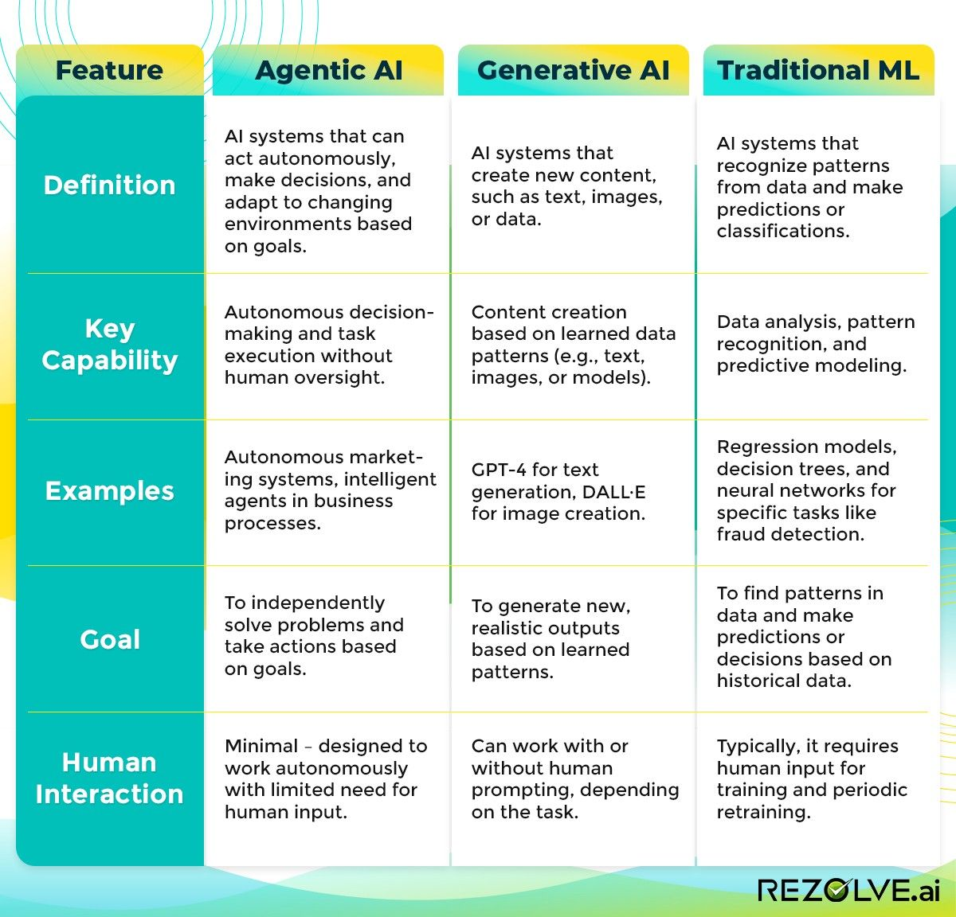

Slide 10
Key components of a Deep Learning syllabus:
1. Fundamentals of Neural Networks:
Introduction to Artificial Neural Networks (ANNs)
Perceptron model
Activation functions (sigmoid, ReLU, tanh)
Backpropagation algorithm
Gradient descent optimization
2. Deep Learning Architectures:
Multi-Layer Perceptron (MLP)
Convolutional Neural Networks (CNNs)
Recurrent Neural Networks (RNNs)
Long Short-Term Memory (LSTM)
Generative Adversarial Networks (GANs)
Autoencoders
3. Advanced Optimization Techniques:
Momentum, RMSprop, Adam optimizer, and Learning rate scheduling.
4. Practical Implementation with Libraries:
TensorFlow, PyTorch, Keras, Data preprocessing and augmentation, and Model training and evaluation metrics.
5. Applications of Deep Learning:
Computer Vision
Image classification
Object detection
Image segmentation
Natural Language Processing (NLP)
Text classification
Sentiment analysis
Machine translation
Speech Recognition
Time Series Analysis
6. Ethical Considerations:
Bias in data and models, Privacy concerns, Explainability and interpretability, and Responsible AI practices.
Important Points to Consider:
Prerequisites:
A solid understanding of linear algebra, calculus, probability, and programming skills (usually Python) are required to fully grasp deep learning concepts.
Hands-on Projects:
Implementing various deep learning models on real-world datasets is crucial for gaining practical experience.
Stay Updated:
Deep learning is rapidly evolving, so continuous learning about new research and techniques is important.

Slide 11
https://medium.com/towards-data-science/what-the-hell-is-perceptron-626217814f53

Slide 12
Introduction to Deep Learning
Deep Learning (DL) is a subset of Machine Learning that utilizes artificial neural networks with multiple layers to learn complex patterns in data. It enables high-level feature extraction from raw data and is the foundation for many modern
AI applications.
Key Aspects of Deep Learning:
Multi-layered neural networks (deep networks) that extract hierarchical features.
Requires large datasets and significant computational power (e.g., GPUs, TPUs).
Performs exceptionally well in tasks like image recognition, natural language processing, and speech synthesis.

Slide 13
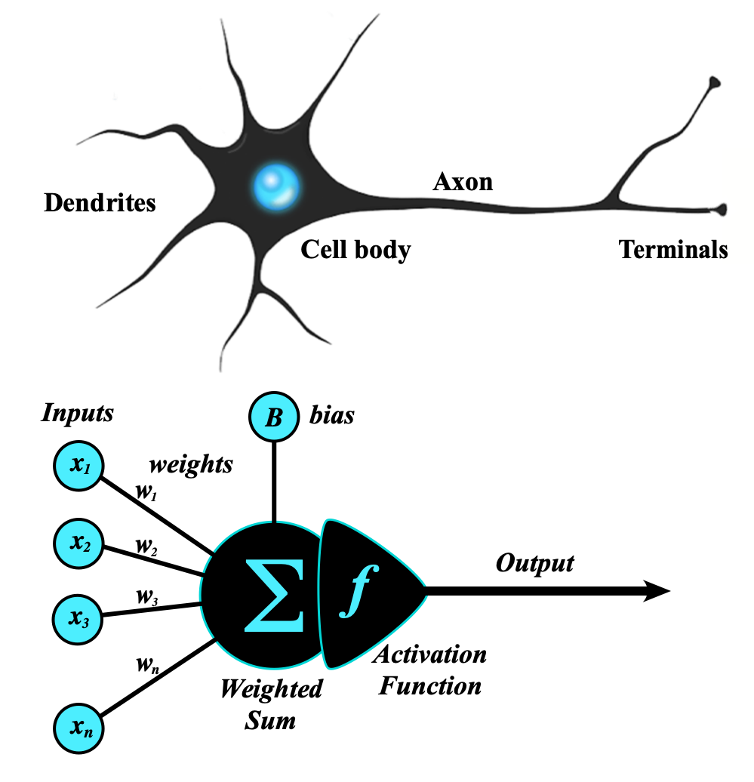
Artificial Neural Network
An artificial neural network (ANN) is a computational network (a system of nodes and the interconnection between nodes) inspired by biological neural networks, which are the complex networks of neurons in human brains (see Figure).
The nodes created in the ANN are supposedly programmed to behave like actual neurons, and hence they are artificial neurons.
The Perceptron was invented in 1957 by Frank Rosenblatt at the Cornell Aeronautics Laboratory. Based on the first concepts of artificial neurons, he proposed the “Perceptron learning rule“.
https://www.geeksforgeeks.org/neural-networks-a-beginners-guide/
https://s.mriquestions.com/what-is-a-neural-network.html

Slide 14
Types of Neural Networks
Deep learning includes various types of neural networks optimized for specific tasks:
Perceptron (Single Neuron )
Multi Layer Perceptron (Multiple Neuron)
ANN
Feedforward Neural Networks (FNN):
Basic architecture where information moves in one direction.
Used in classification and regression tasks.
Convolutional Neural Networks (CNN):
Specialized for image processing tasks.
Uses convolutional layers to detect spatial features.
Recurrent Neural Networks (RNN):
Designed for sequential data like time series and speech.
Uses loops and memory to retain information from previous inputs.
Long Short-Term Memory (LSTM):
A type of RNN that solves the vanishing gradient problem.
Used in text generation, language modeling, and speech recognition.
Generative Adversarial Networks (GANs):
Consist of a generator and a discriminator that compete to generate realistic data.
Used in AI-generated art, deepfake videos, and data augmentation.
https://www.geeksforgeeks.org/neural-networks-a-beginners-guide/

Slide 15
Perceptron Model
The perceptron is the simplest form of an artificial neural network and serves as the building block of more advanced models.
Components of a Perceptron:
Inputs: Feature values from the dataset.
Weights: Assigned to each input to signify importance.
Summation Function: Computes the weighted sum of inputs.
Activation Function: Applies a threshold to determine output.

Slide 16
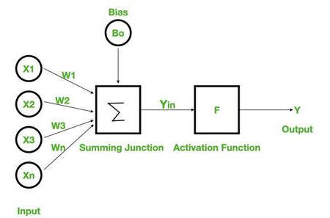
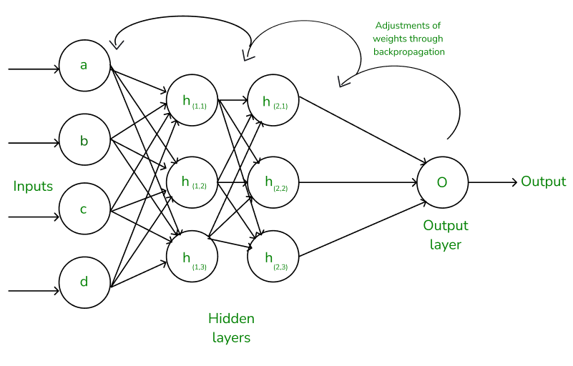
Types of Perceptron Models:
Single-layer perceptron: Can only solve linearly separable problems.
Multi-layer perceptron (MLP): Can solve non-linear problems using multiple layers.
Neural Networks Architecture:
the basic elements of the network's architecture.
made of three core layers:
Input layer
Hidden layers
Output layer

Slide 17
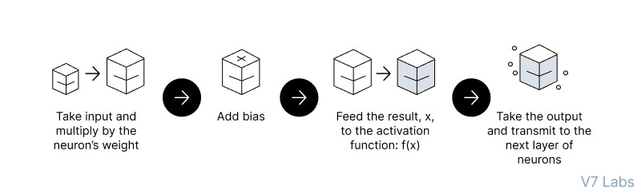
Feedforward Neural Networks (FNN):
the flow of information occurs in the forward direction. The input is used to calculate some intermediate function in the hidden layer, which is then used to calculate an output.
2. Backpropagation
- the weights of the network connections are repeatedly adjusted to minimize the difference between the actual output vector of the net and the desired output vector.
Implement the FNN
https://colab.research.google.com/drive/1z_nL3RcvR1x4uIR88VWEj8Zdr7mYEcQK#scrollTo=keCSdzvOrRmx

Slide 18
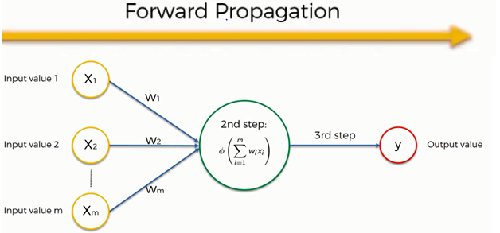
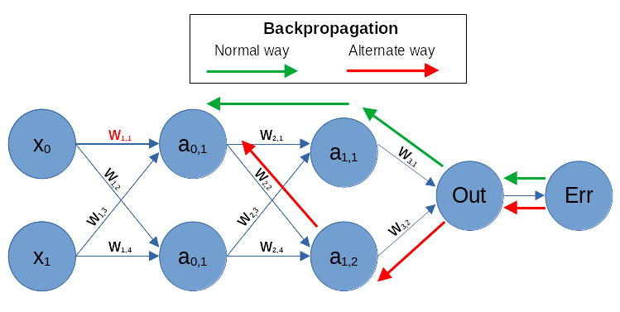
Working of Neural Networks
Forward Propagation
input
calculation -->then apply activation func
output
Backpropagation
Loss Calculation
Gradient Calculation
Weight Update
https://www.guru99.com/backpropogation-neural-network.html
Feedforward vs. Backpropagation
https://www.geeksforgeeks.org/backpropagation-in-neural-network/

Slide 19
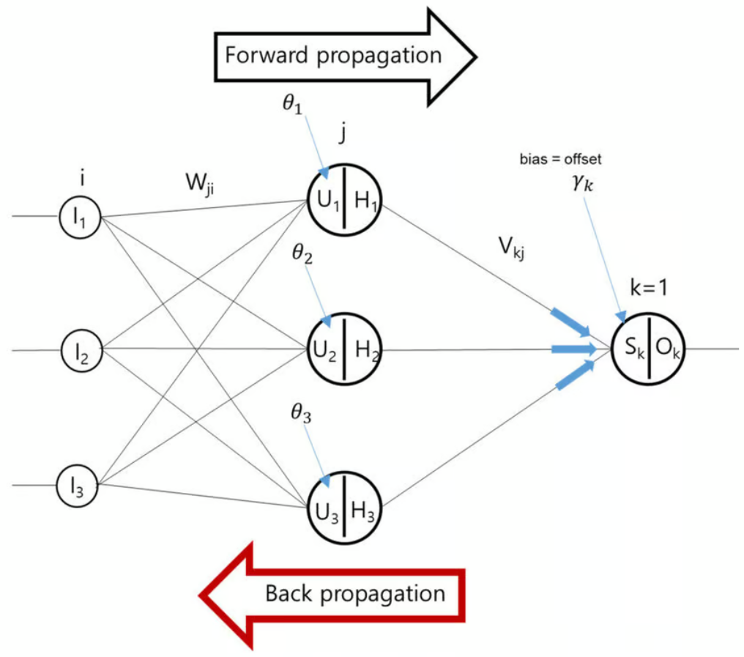
Terms Neural Networks Architecture:
features
weights
bias
USE IN ANN
for non linearity in neural network
activation functions
for error calculations
mse,mae, logloss
for optimizations
gradient descent/ optimzer
4. Evaluation Matrix
classification
regression

Slide 20
What we learn
Introduction to AI
AI vs ML vs DL
Applications of AI
Conventional AI vs GenAI
Future of AI
Introduction to DL
Introduction to Deep Learning
Perceptron Model
Introduction to Tensorflow and Keras
Introduction to Types of Neural Networks
Artificial Neural Network Deep Dive
Activation Functions in NN
Loss Functions
Optimization Technique
Regularization Techniques
CallBacks
Computer Vision
Object Detection
Region Proposal Techniques
Semantic Segmentation
Computer Vision with OpenCV
Working with images
Working with Videos
OCR
Media Pipe - FaceMesh, Pose Detection
Convolution Neural Network
Introduction to CNN
Architecture of CNN - Kernel / Filter, Stride, Padding, Activation Function Max Pooling and Avg Pooling
Natural Language Processing
Introduction to NLP
Text Preprocessing
Text Vecorization and Classification
Embedding Layer in Natural Language Processing
Sentiment Analysis
Sequence Model
Machine Translation
Introduction to LLM
Recurrent Neural Network
Introduction to RNN
LSTM
Bi-directional LSTM
GRU

Slide 21
RASA Chatbot
What is RASA
RASA Installation
RASA Initialization
RASA Configuration and File System
Intents, Entity,Response and Story
Actions
Stock Price Prediction using Sequence Model
Introduction to Sequence Models RNN, LSTM
Preparing Time Series Data for LSTM
Forecasting using LSTM
Future Forecast
Assignment
Introduction to Time Series Analysis
What is Sequential Data & Time Series
Functional Relationship
Components of Time Series
Mathemetical Representation of Time Series
ETS Decompositon
Classification of Time Series
Defference between ACF & PACF
Assignment
Weather Forecasting using ARIMA Model
Introduction to AR and MA model
Stationarity & Differencing
SariMax of Seasonal Data
Identifying order AR(p), I(d), MA(q)
Implementation of ARIMA
Assignment

Slide 22
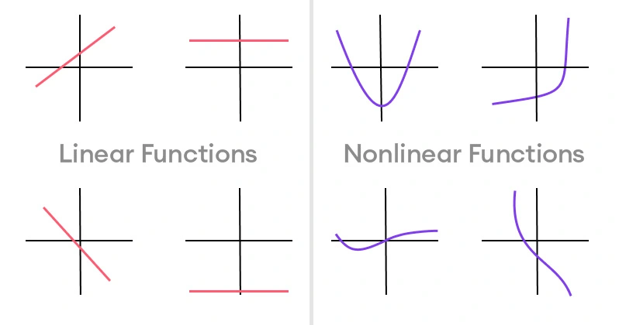
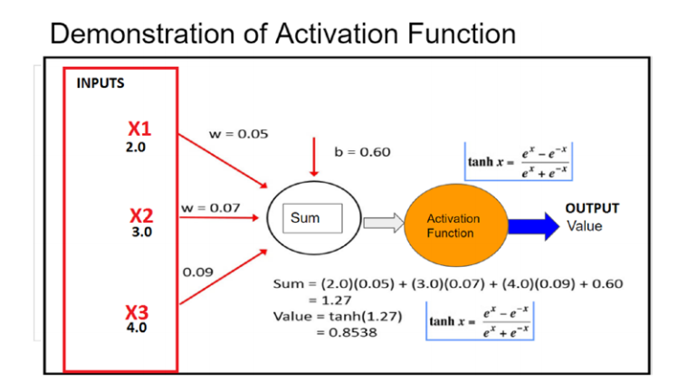
Activation functions
https://www.superannotate.com/blog/activation-functions-in-neural-networks

Slide 23
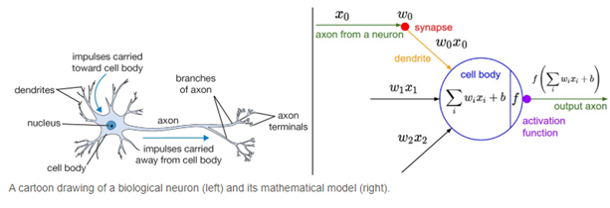
What is a Neural Network Activation Function?
An Activation Function decides whether a neuron should be activated or not. This means that it will decide whether the neuron’s input to the network is important or not in the process of prediction using simpler mathematical operations.
The role of the Activation Function is to derive output from a set of input values fed to a node (or a layer).
Activation functions play a crucial role in neural networks by introducing non-linearity, enabling the model to learn and represent complex patterns. Without activation functions, a neural network behaves like a linear model, limiting its ability to capture intricate relationships in data.

Slide 24
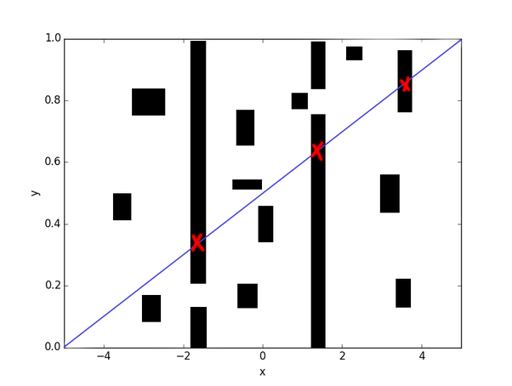
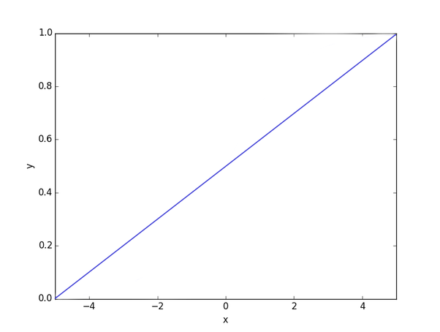

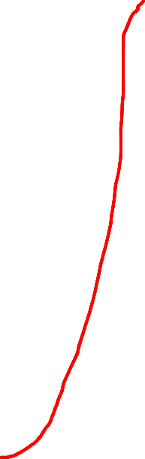

Sometimes it’ll be more difficult. You’ll have to go through very specific spots and avoid others:
Why Neural Networks Need Activation Functions?
Imagine that a neural network is a hose:
It takes water (takes some input), carries it somewhere (modifies your input), and pushes water out (produces some output).
Without an activation function, your hose will act more like a steel pipe: fixed and inflexible. Sometimes that’s good enough. Nothing wrong with using a pipe to deliver your water:
An inflexible steel pipe just won’t fit no matter how you rotate it. An ctivation function comes in handy here, because it allows your function to be more flexible.
In this case, a neural net with an activation function would act like a plastic garden hose. You can bend it to your specific needs and carry your water to a lot more places that are impossible to reach with a steel pipe:

Slide 25
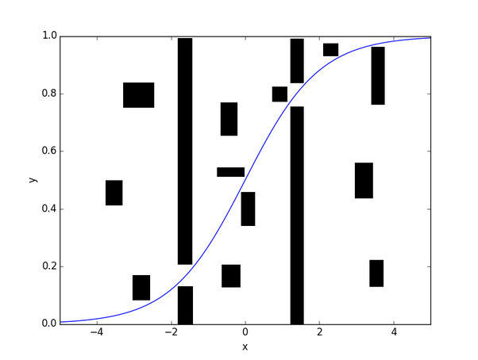
Neural networks require activation functions for several key reasons:
Non-linearity: Activation functions introduce non-linearities into the network. Without them, a neural network would essentially behave like a linear model, regardless of how many layers it has. This means it would be unable to learn complex patterns in the data.
Output Control: Activation functions help control the output of a neuron. For example, in binary classification tasks, using a sigmoid or softmax activation function can produce outputs that can be interpreted as probabilities.
Gradient Propagation: During training, neural networks rely on backpropagation to update weights. Activation functions help shape the loss surface and can influence the speed and stability of training. Some functions, like ReLU (Rectified Linear Unit), help mitigate issues like vanishing gradients, allowing models to learn faster and perform better.
Thresholding: Certain activation functions (like step functions) can act as thresholds, allowing the model to decide whether to activate a neuron based on whether the input exceeds a certain value. This can help in decision-making processes.
Diversity of Outputs: Different activation functions can create diverse output distributions, allowing the neural network to learn a variety of tasks effectively. For instance, ReLU is often used in hidden layers for its simplicity and efficiency, while softmax is commonly used in output layers for multi-class classification.
So, the purpose of an activation function is to add flexibility to your hose (non-linearity to your neural net).
Overall, activation functions are crucial for enabling neural networks to learn complex relationships and make accurate predictions.

Slide 26
Why do we need non-linear activation functions in a neural network?
To understand why non-linear activation functions are needed, think of neural nets in a mathematical sense. In its simple form, what we are doing is passing some input X and generating some output Y.
More mathematically,
The architecture of the neural network can be thought of as a function which takes an input X and generates some output Y.
f(X)−>Y or f(X)−>Y
So, a problem is just a mathematical function which we are trying to approximate using a neural net. You can read more about universal approximation theorem over here.
If only linear activation functions are used, then the combination of these functions is another linear activation function.
For example:
Let the net input at first layer be as follows:
Z[1]=W[1]∗X+b[1]Z[1]=W[1]∗X+b[1] Equation (1)
After passing through an activation function:
a[1]=g(Z[1])a[1]=g(Z[1])Equation (2)
Now, net input at second layer is:
Z[2]=W[2]∗a[1]+b[2]Z[2]=W[2]∗a[1]+b[2]Equation(3)
If the activation function is linear then, a[1]=c∗Z[1]a[1]=c∗Z[1]

Slide 27
That is, some multiple (c) of the net input would be the resultant output after passing through a linear activation function.
For simplicity, let c = 1 and substitute the value of a[1]a[1]in equation 3.
We get,
Z[2]=W[2]∗Z[1]+b[2]Z[2]=W[2]∗Z[1]+b[2]
which is,
Z[2]=W[2]∗W[1]∗X+b[1]+b[2]Z[2]=W[2]∗W[1]∗X+b[1]+b[2]From equation 1
This result can be written as:
Z[2]=W′X+B′Z[2]=W′X+B′
The result is just another linear function and this process will continue even in further layers.
Simple linear functions cannot approximate every function f(X). Hence, we require non-linear activation functions in neural nets.
https://www.quora.com/Why-do-neural-networks-need-an-activation-function

Slide 28
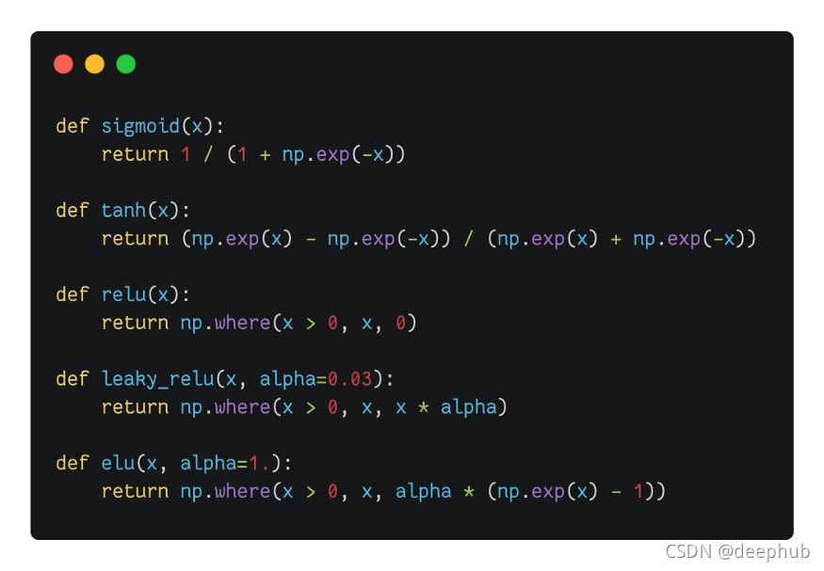
TYPES ON NON-LINEAR ACTIVATIONS
Sigmoid / Logistic Activation Function
Tanh Function (Hyperbolic Tangent)
ReLU Function
Leaky ReLU Function
Parametric ReLU Function
Exponential Linear Units (ELUs) Function
Softmax Function
OPTIONAL:-(Swish,Gaussian Error Linear Unit (GELU), Scaled Exponential Linear Unit (SELU),
https://www.datacamp.com/tutorial/introduction-to-activation-functions-in-neural-networks
https://www.v7labs.com/blog/neural-networks-activation-functions

Slide 29
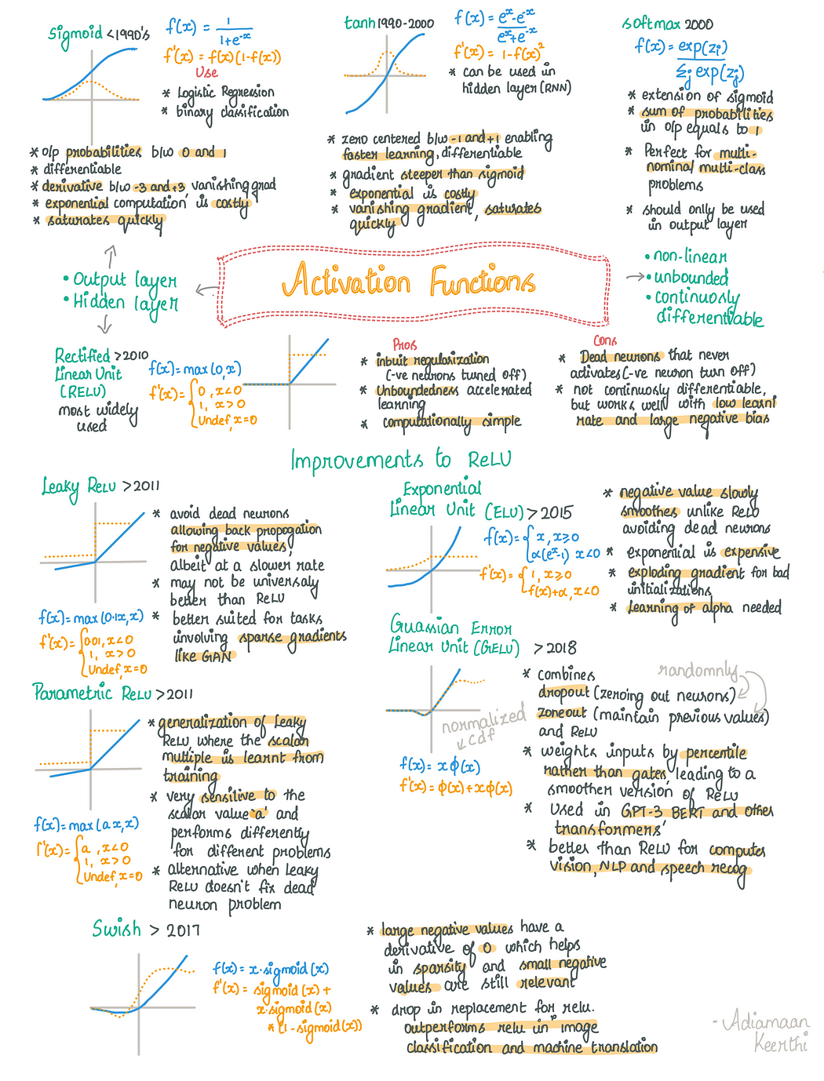

Slide 31
References:
https://www.geeksforgeeks.org/activation-functions-neural-networks/
https://www.v7labs.com/blog/neural-networks-activation-functions
https://www.datacamp.com/tutorial/introduction-to-activation-functions-in-neural-networks
https://encord.com/blog/activation-functions-neural-networks/
https://www.analyticsvidhya.com/blog/2021/04/activation-functions-and-their-derivatives-a-quick-complete-guide/
https://www.superannotate.com/blog/activation-functions-in-neural-networks
chatgpt
https://blog.csdn.net/deephub/article/details/120234480
vvvi
https://blog.csdn.net/weixin_39910711/article/details/114849349

Slide 32
Introduction to TensorFlow and Keras
TensorFlow and Keras are two of the most widely used deep learning frameworks.
TensorFlow:
Developed by Google Brain.
Provides low-level and high-level APIs for building deep learning models.
Supports large-scale machine learning and deployment.
Keras:
High-level API built on TensorFlow.
Simplifies model building and experimentation.
Allows quick prototyping with minimal code.

Slide 33
TensorFlow code
What is TensorFlow?
TensorFlow is an end-to-end open-source machine learning platform with a focus on deep neural networks. Deep learning is a subtype of machine learning that analyses massive amounts of unstructured data. Since it works with structured data, deep learning is different from normal machine learning.
importtensorflowastfprint("TensorFlow version:",tf.__version__)
How to install TensorFlow ?
pip install tensorflow
If you have a good graphics card in your computer,
pip install tensorflow-gpu
Check Installation
import tensorflow as tf
print(tf.__version__)
Some TensorFlow Fundamentals

Slide 34
Some TensorFlow Fundamentals
a tensor is a multi-dimensional array of data that can be used to represent data and perform mathematical operations. Tensors are a generalization of vectors and matrices,
What are tensors used for?
Training neural networks: Tensors store the weights and parameters of neural networks, and are used in the algorithms that train them
Representing data: Tensors can represent data such as images, movies, sounds, and relationships between words
Clustering: Tensors can be used in clustering algorithms such as k-means clustering
Support vector machines: Tensors can represent data in support vector machines
Why are tensors important?
Tensors are efficient with memory, making them ideal for parallel computing environments
Tensors are versatile and efficient at handling data

Slide 35
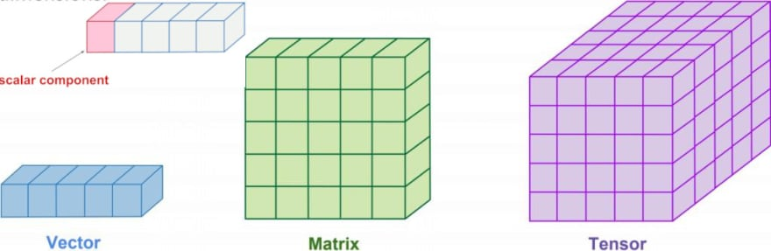
What are tensors built from?
The values in a tensor contain identical data types with a specified shape. Dimensionality is represented by the shape. A vector, for example, is a one-dimensional tensor, a matrix is a two-dimensional tensor, and a scalar is a zero-dimensional tensor.
import tensorflow as tf
x=tf.constant([[1.,2.,3.],[4.,5.,6.]])
print(x)
print(x.shape)
print(x.dtype)

Slide 36
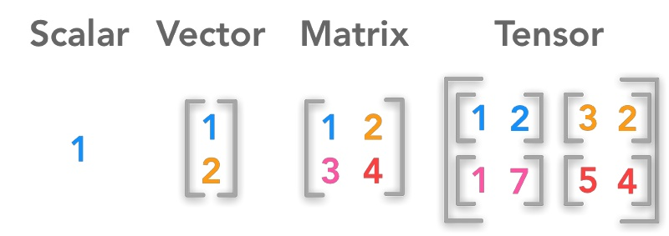
Shape
In the TensorFlow Python library, the shape corresponds to the dimensionality of the tensor. In simple terms, the number of elements in each dimension defines a tensor’s shape.

